Slide 1



Statistical Analysis and Learning (SAL): (Tree-Based Methods, ISL Ch8) Textbook: An Introduction to Statistical Learning (ISL)
Varun Rai
LBJ School of Public Affairs
The University of Texas at Austin
4th April 2018

Slide 2
Note on Material
Unless otherwise noted, all material in this presentation are from this course’s textbook, An Introduction to Statistical Learning (ISL)

Slide 3
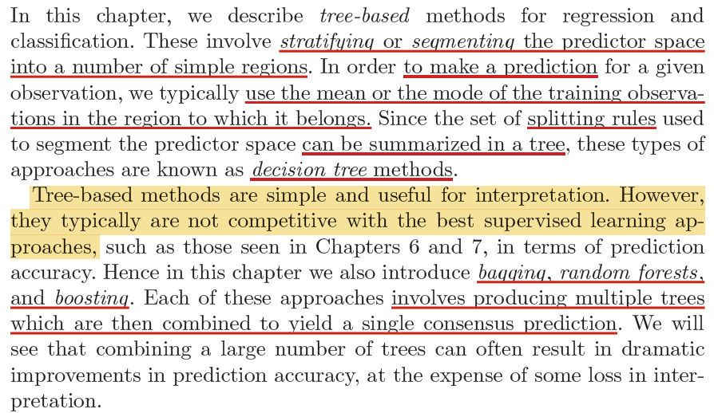
Tree-Based Methods

Slide 4
Regression Trees

Slide 5
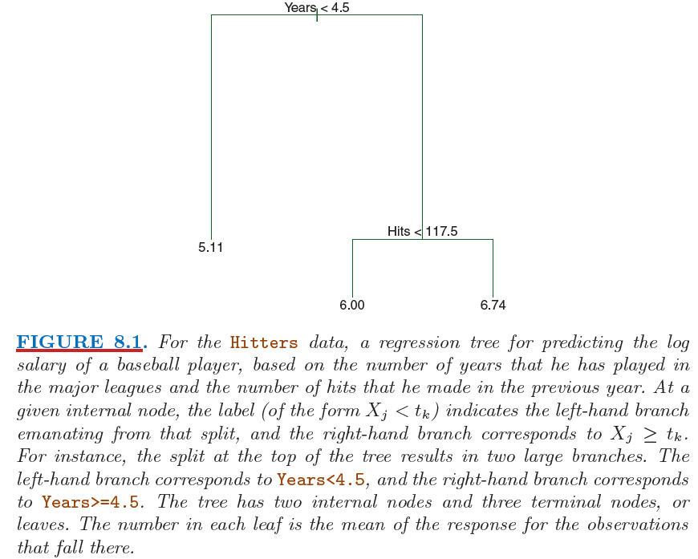
Tree-Based Methods

Slide 6
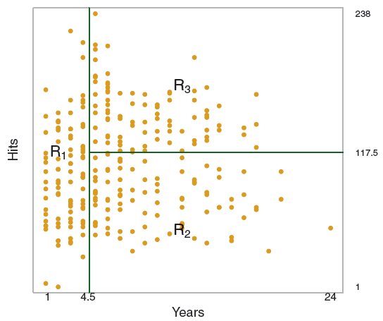
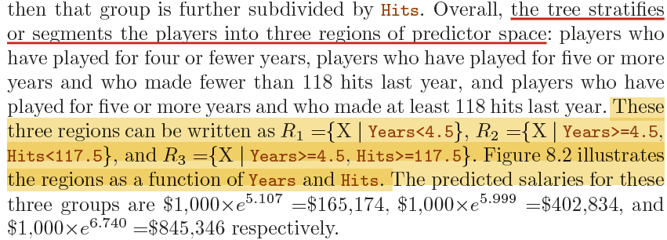
Regression Trees

Slide 7
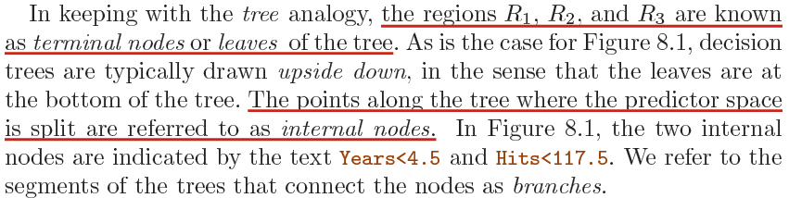
Regression Trees

Slide 8
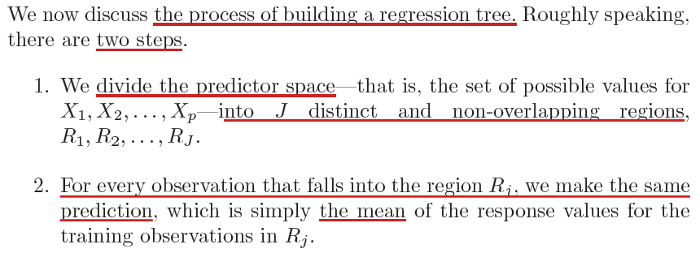
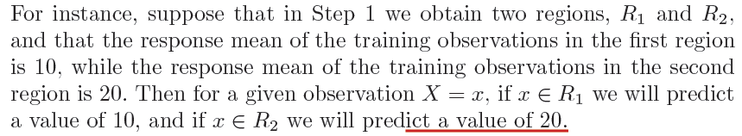
Predicting via Stratification of the Predictor (Feature) Space

Slide 9
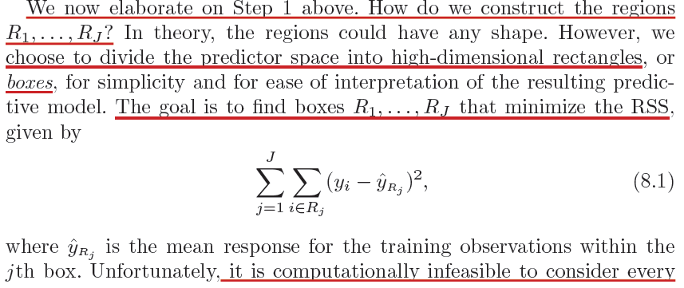
Predicting via Stratification of the Predictor (Feature) Space

Slide 10
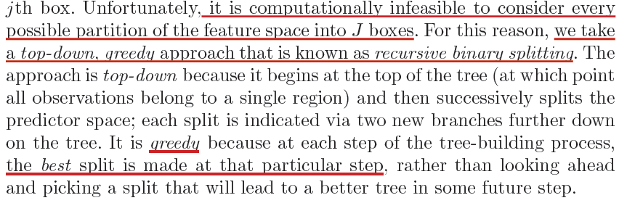
Predicting via Stratification of the Predictor (Feature) Space

Slide 11
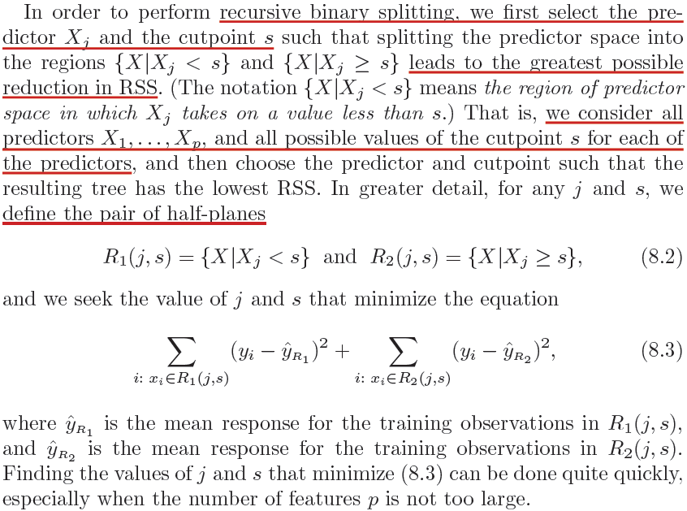
Predicting via Stratification of the Predictor (Feature) Space

Slide 12
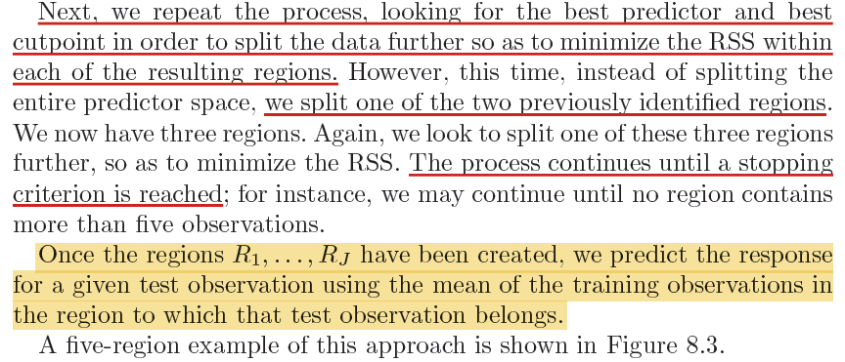
Predicting via Stratification of the Predictor (Feature) Space

Slide 13
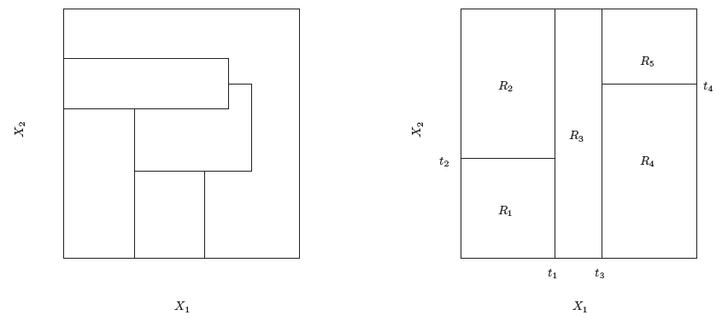
Predicting via Stratification of the Predictor (Feature) Space
Notes:
Left: A partition of two-dimensional feature space that could
not result from recursive binary splitting. Right: The output of recursive
binary splitting on a two-dimensional example.

Slide 14
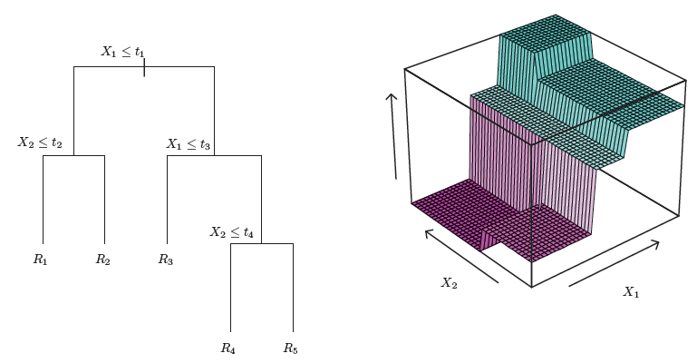
Predicting via Stratification of the Predictor (Feature) Space

Slide 15
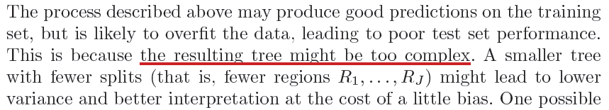
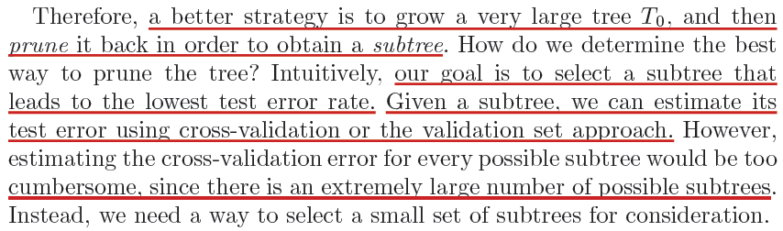
Tree Pruning

Slide 16
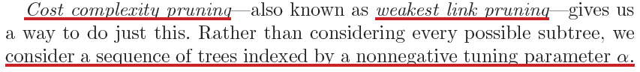
Cost Complexity Pruning

Slide 17
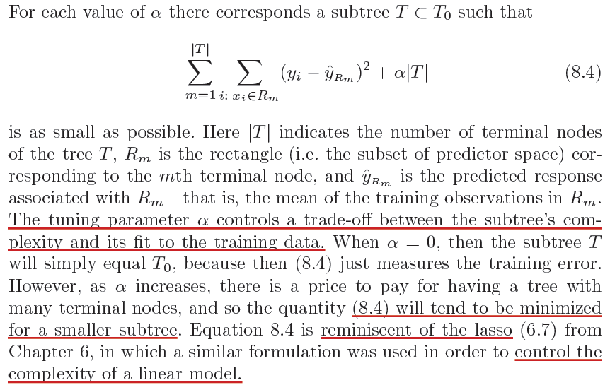
Cost Complexity Pruning

Slide 18
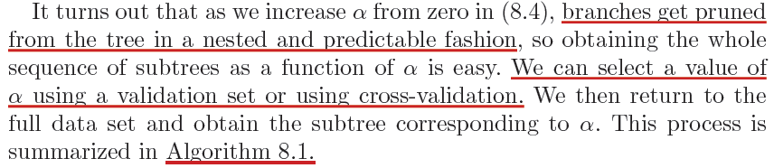
Cost Complexity Pruning

Slide 19
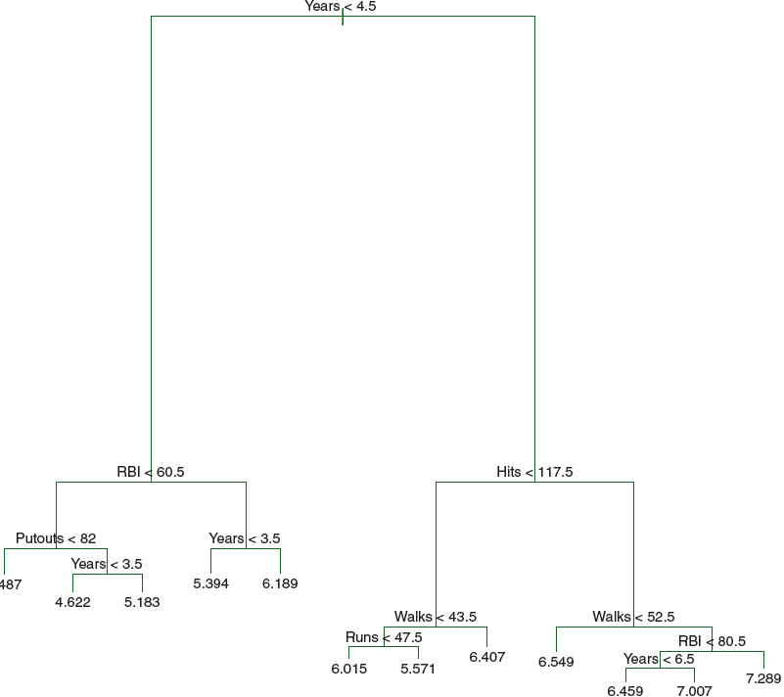

Slide 20
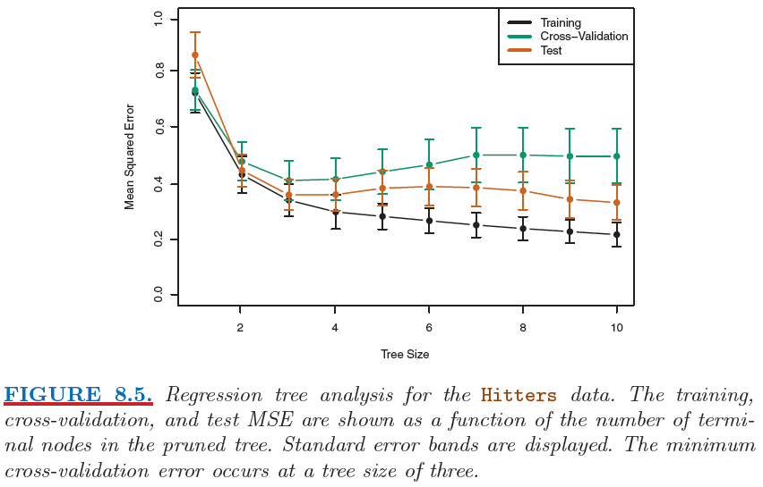
Cost Complexity Pruning

Slide 21
Classification Trees
Notes:
Begin session 2

Slide 22
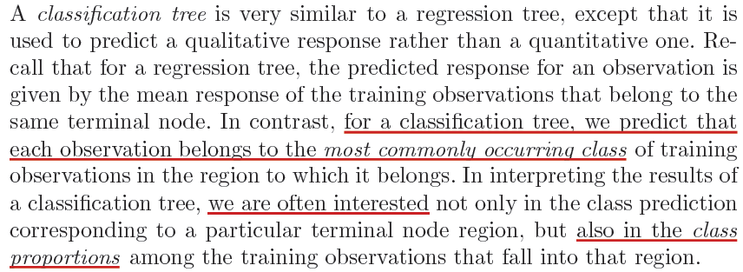
Classification Trees

Slide 23
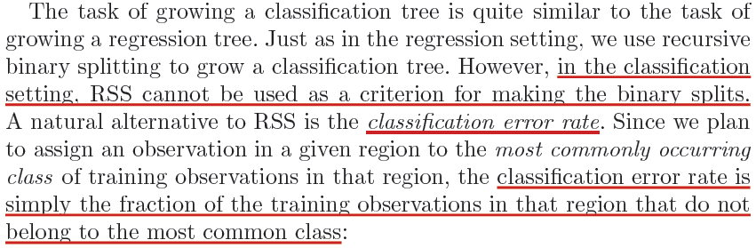
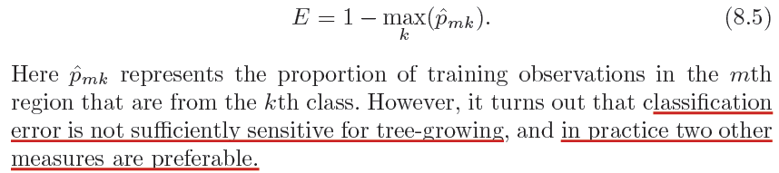
Classification Trees

Slide 24
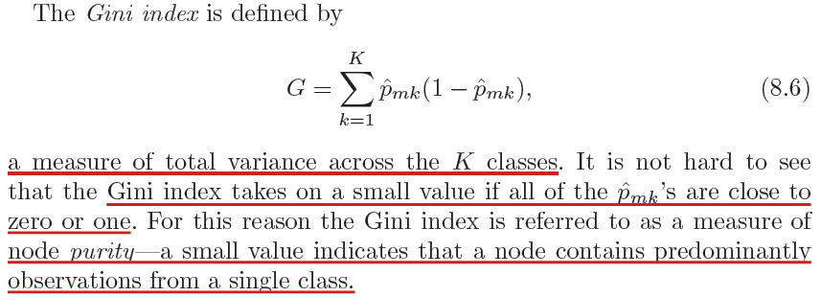
Classification Trees: Gini Index

Slide 25
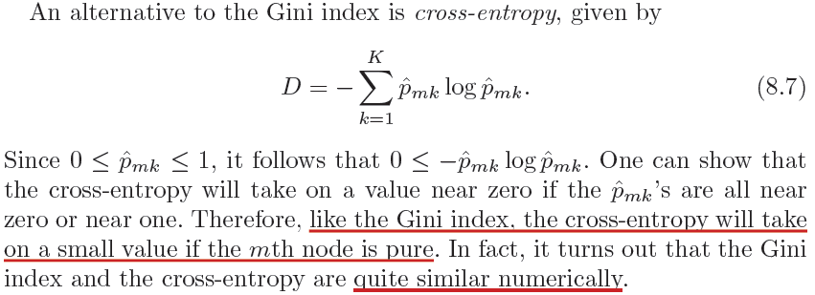
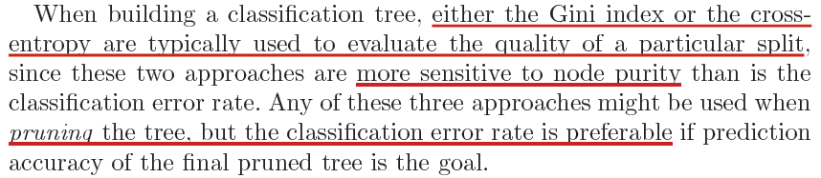
Classification Trees: Cross Entropy

Slide 26
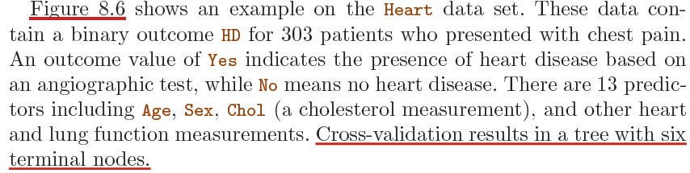
Classification Trees

Slide 27
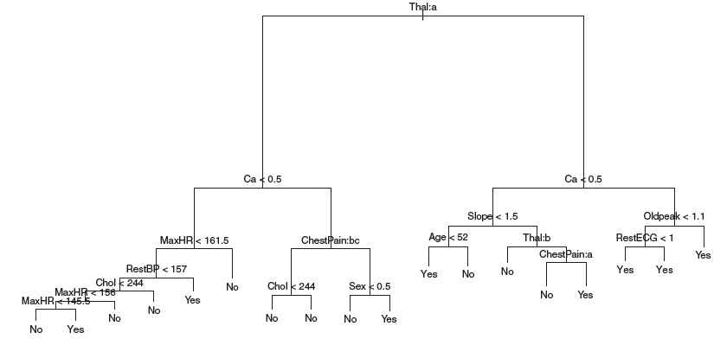
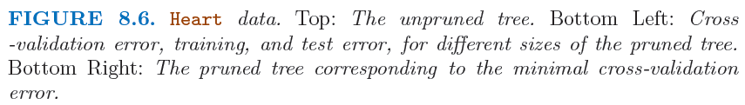
Classification Trees

Slide 28
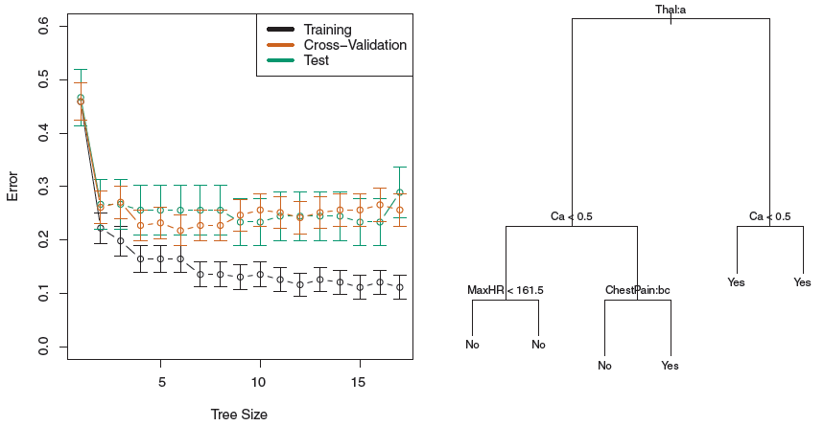
Classification Trees

Slide 29
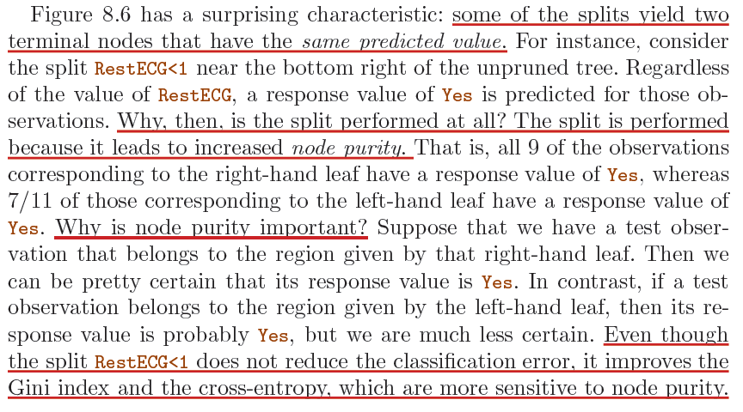
Classification Trees

Slide 30
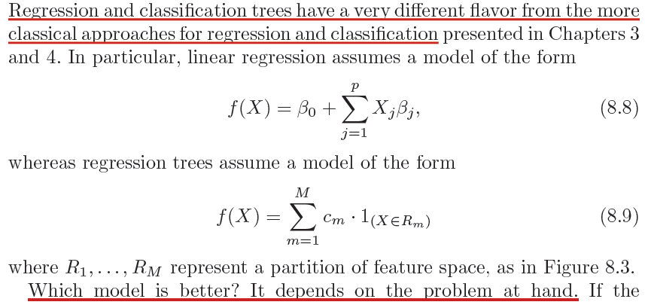
Tree vs. Linear Methods

Slide 31
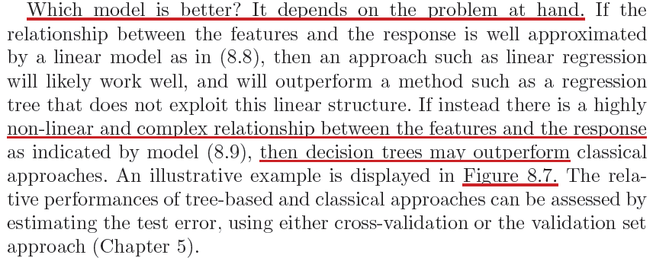
Tree vs. Linear Methods
Notes:
Begin session 2

Slide 32
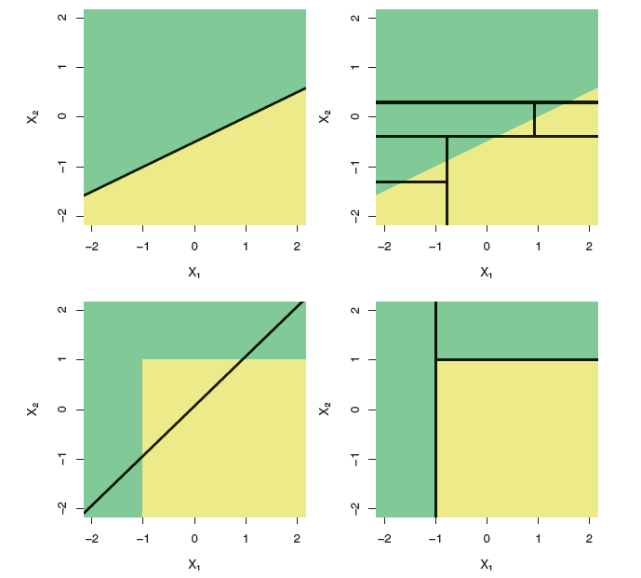
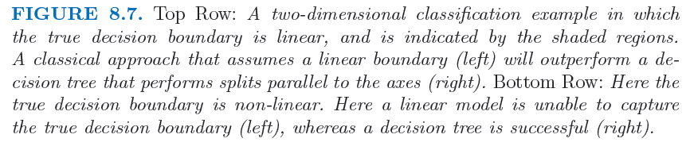

Slide 33
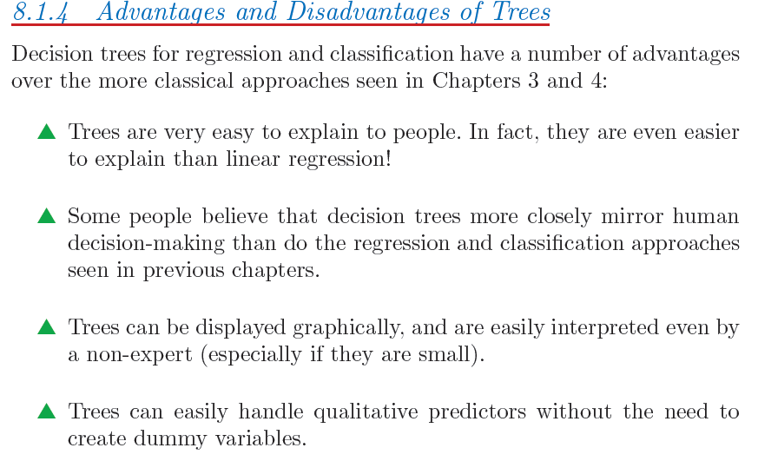
Tree-Based Methods

Slide 34
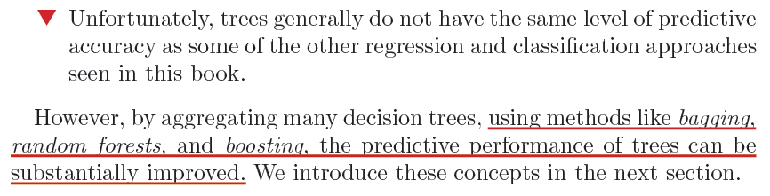
Tree-Based Methods, Disadvantages
Notes:
End of session 1

Slide 35
Bagging, Random Forest, and Boosting
Notes:
Begin session 2

Slide 36
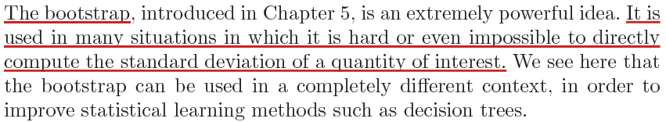
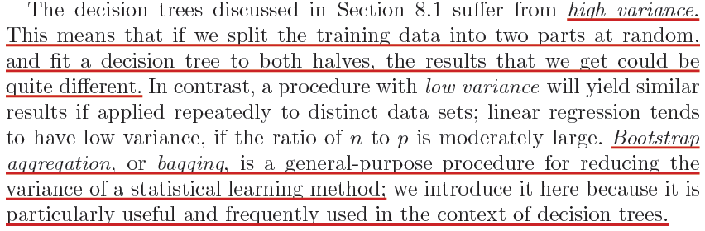
Bagging

Slide 37
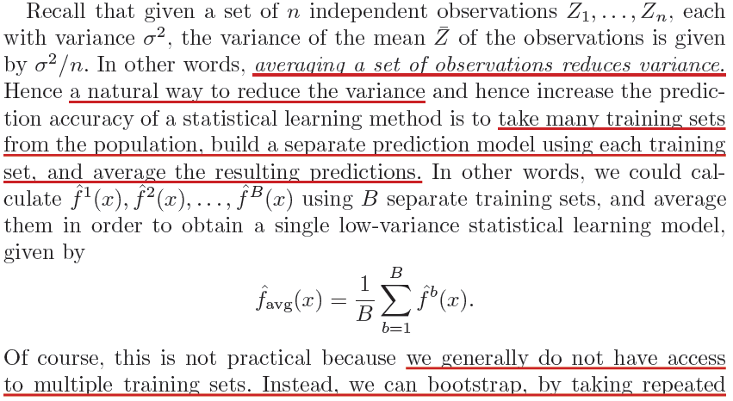
Bagging

Slide 38
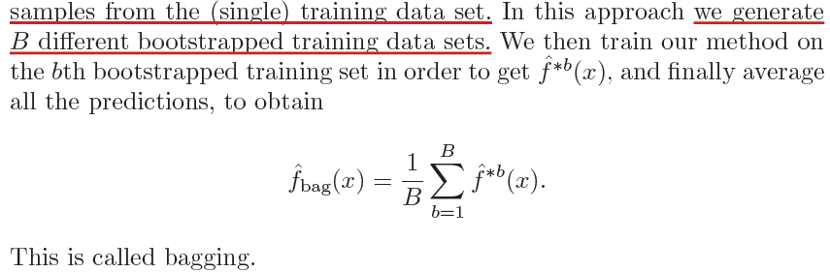
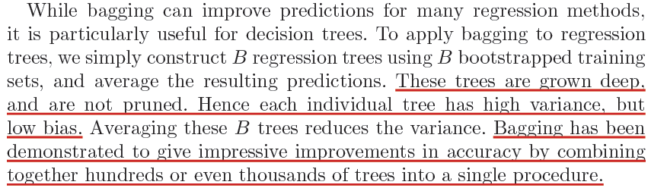
Bootstrap...

Slide 39
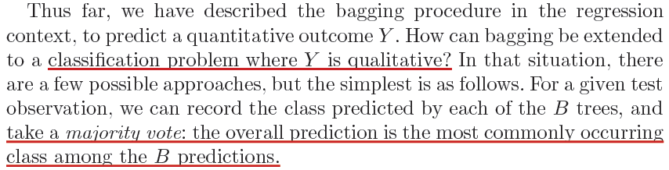
Bagging, Qualitative Response

Slide 40
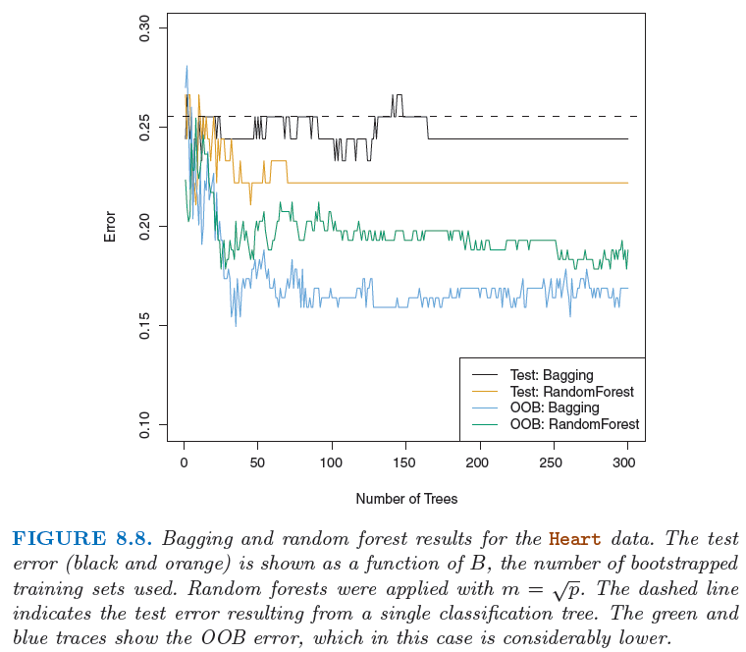
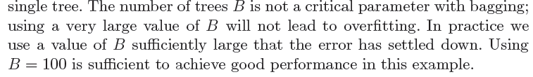
Bagging

Slide 41
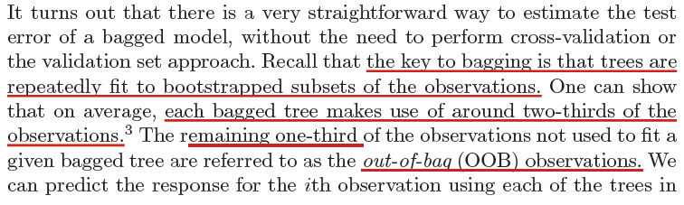
Estimating the Out-of-Bag (OOB) Error

Slide 42
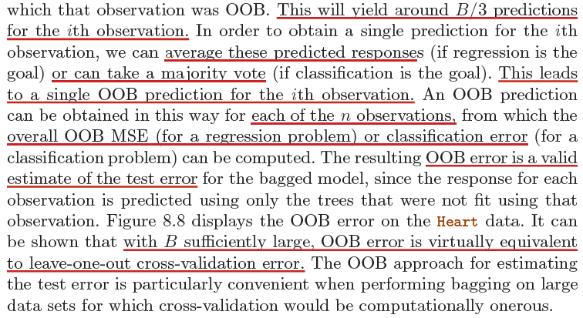
Estimating the Out-of-Bag (OOB) Error

Slide 43
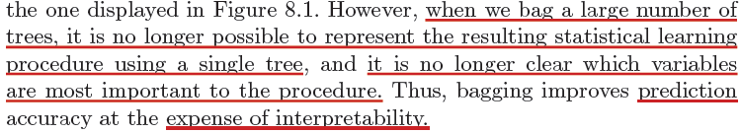
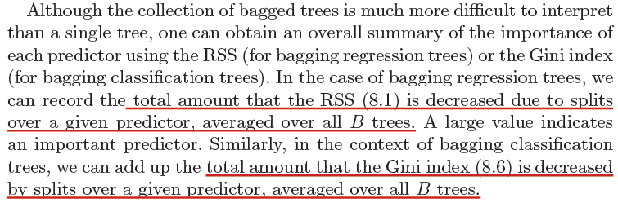
Measures of Variable Importance

Slide 44
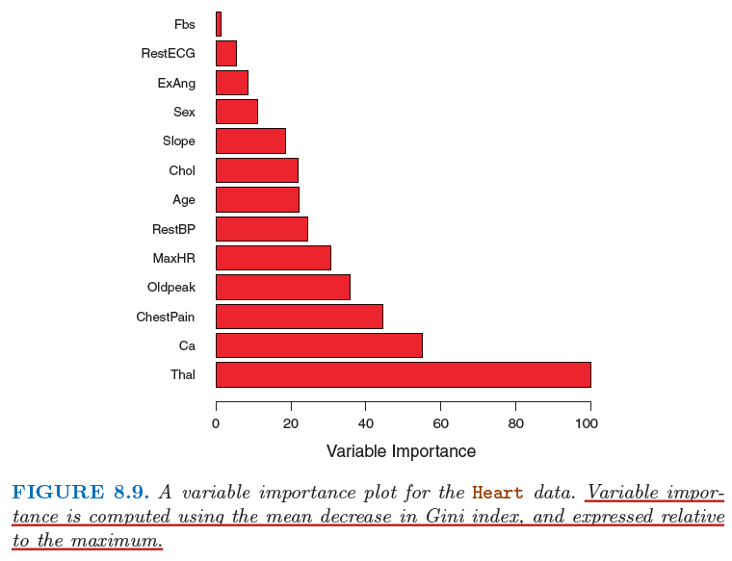
Variable Importance

Slide 45
Random Forests
Notes:
Begin session 3

Slide 46

Random Forests

Slide 47

Random Forests

Slide 48

Random Forests
Notes:
(p-m)/p: ~ C(p-1,m)/C(p,m); probability of a particular variable NOT in the chosen m predictor set over the probability of all m predictor sets.

Slide 49


N=349
p=500
Choosing large B doesn’t lead to overfitting. So choose sufficiently large B.

Slide 50
Boosting

Slide 51



Boosting

Slide 52

Boosting

Slide 53

Boosting

Slide 54

Boosting

Slide 55

Boosting

Slide 56

Boosting
Notes:
End of session 2

Slide 57

End of Lecture #10
Source: http://yaroslavvb.blogspot.com/

